Slide 1
Discord SET Bot Midterm Project Report
Alex Algazi asa10@hood.edu
4/4/22

Slide 2
What is Discord?
VoIP/instant messaging platform (2015)
Communities: guilds, or “servers”
Extensive API for bots
Bots range from call-and-response text messaging to music streaming
Initially popular among video game enthusiasts, now general purpose
Bots introduced with official API (2016)
Notable examples of game bots include:
Pokétwo - emulates the experience of playing a Pokémon game
EPIC RPG - a bot which has dungeons and an in-game economy, as well as PVP
Gamebot - collection of games, including Chess, Connect 4, and Cards Against Humanity
However, no one has ever attempted to make a bot for the SET card game…

Slide 3

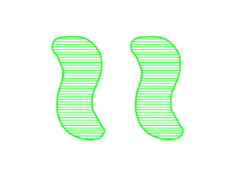
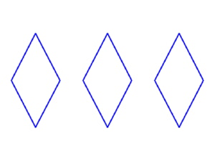
What is SET?
Pattern-recognition card game, invented in 1974
4 attributes: number, shading, color, and shape
Three possibilities for each attribute:
Number: One, Two, Three
Shading: Solid, Striped, Open
Color: Red, Green, Blue
Shape: Oval, Squiggle, Diamond
81 cards in the deck, one for each combination (3⁴)
A set is a group of three cards where each attribute is either the same for all three cards OR different for all three cards
Players compete to find sets on the board

Slide 4
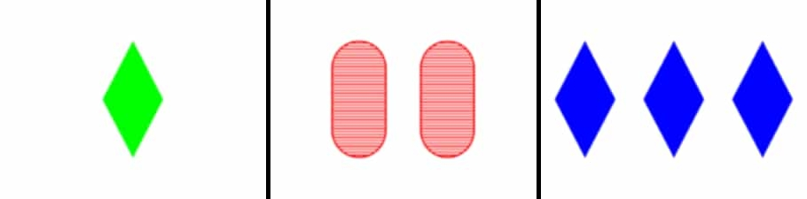

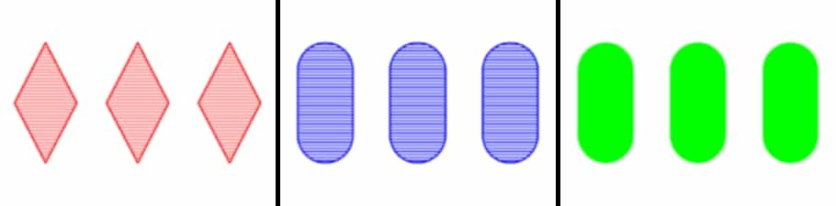


Slide 5
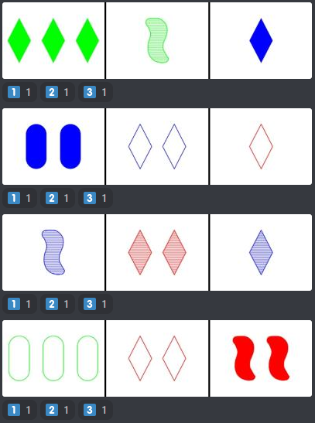
Objectives
Generate board visible to all
Recognize sets using arithmetic
Check boards for sets, add 3 if no set
User inputs using Discord emojis
Regenerate the board after set is found
Show user scores in a leaderboard
Track relevant statistics in each guild

Slide 6
Project Plan
Create a game loop
Encode the cards mathematically
Stitch images of the cards together into rows
Use reaction collectors to record user inputs
Check the board for sets efficiently
Store game data in a JSON file
Send game data to a database
Host the bot on Hood’s “pluto” server

Slide 7
Tech Stack
JavaScript, for the game logic
Node.js, a server-side runtime environment
Discord.js, a Node framework for the Discord API
SQLite, to store game data in a discrete file
pluto@hood.edu, as a host for the bot and all its data
Required Functionality/Features
“/newgame” command starts game, generating a board
Players select cards; when set is found, replace used cards
Game continues until deck is empty or game is cancelled
Scores displayed, and saved to DB

Slide 8
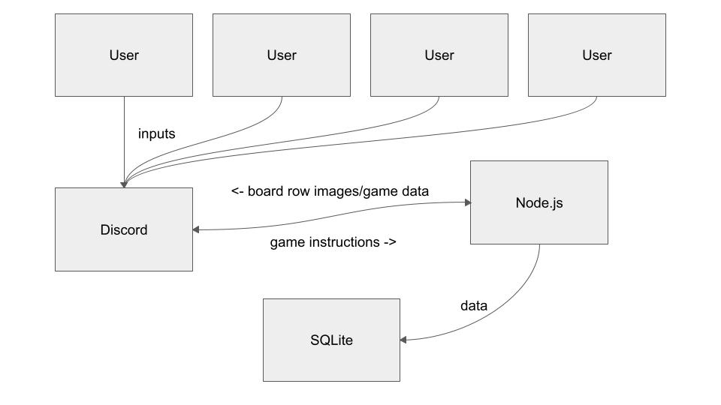
Architecture

Slide 9
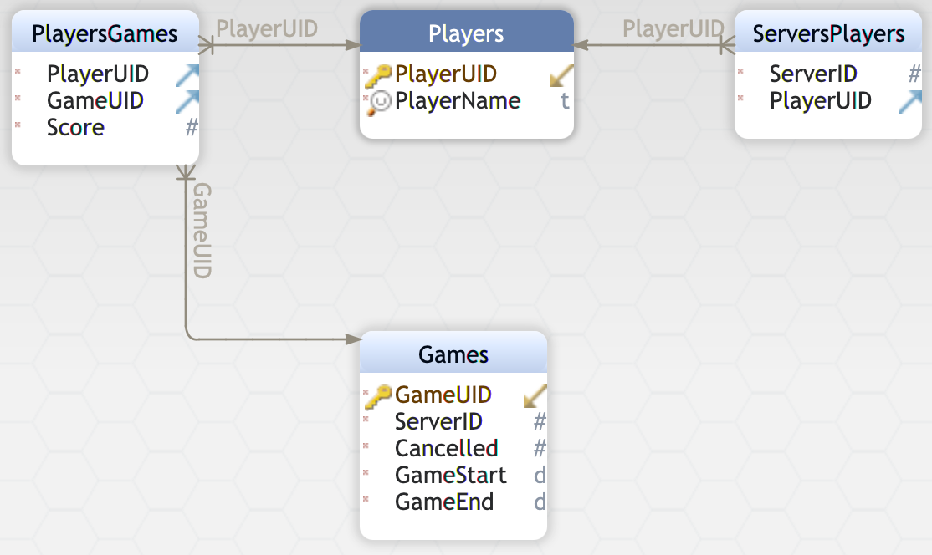
Database Structure

Slide 10
Accomplished Work
Besides the database, all functionalities are implemented
Game loop achieved through recursion
Cards encoded using four digits
Images composited using images.js
Six reaction collectors, one for each row
Boards checked using optimum pair check
Bot not yet hosted, but we have a Unix service file
Main file has 1000+ lines of code
The project is living up to our initial expectations

Slide 11
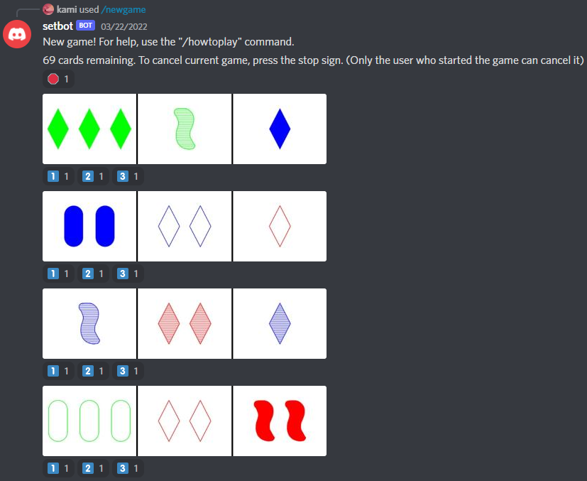
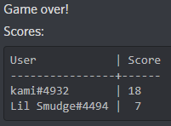

Slide 12
Effort
Team Member Name | Responsibilities/ Accomplishments | Hours Spent
Alex Algazi | Game loop structure General encoding Image generation Game data storage Unix service | 25
Diana Teka | Board set-checker Player scores display Help command “/howtoplay” Database structure | 18

Slide 13
Effort cont.
Communicated using Discord and email
Used clockify for timekeeping
Used Jira to track tasks
Discord is a good platform for communication!
I wish we could have used the in-class time more effectively (more detail in next slide)

Slide 14
Lessons Learned
When environment only allows one user, allocate other tasks to other team members. Taking turns does not work
We needed more time to consider our overall structure. In retrospect, due to our inexperience with the platform, this could not have been easily avoided

Slide 15
What’s Next?
Database inserts and queries
Hood pluto server hosting

Slide 16
In loving memory of Diana Teka

